Slide 1
HydroponicsMachine
Github repo:
https://github.com/jannepetter/hydroponicsMachine
Sakari Väisänen, Oliver Niskala, Petri Hinttala and Janne Uutela

Slide 2
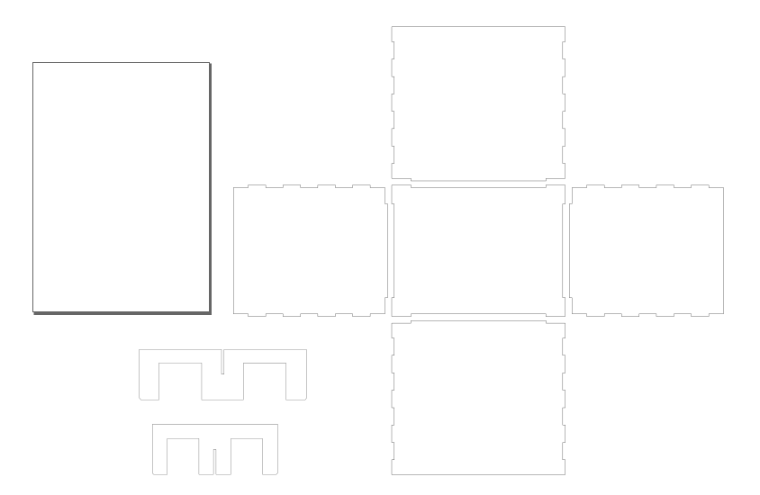
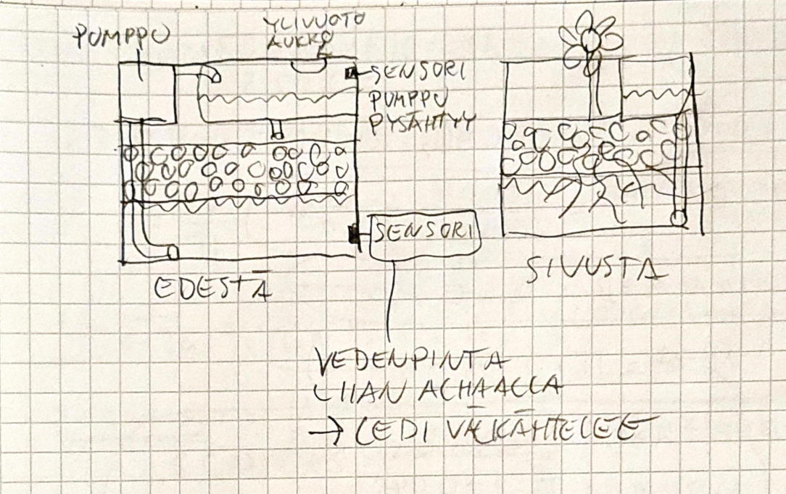
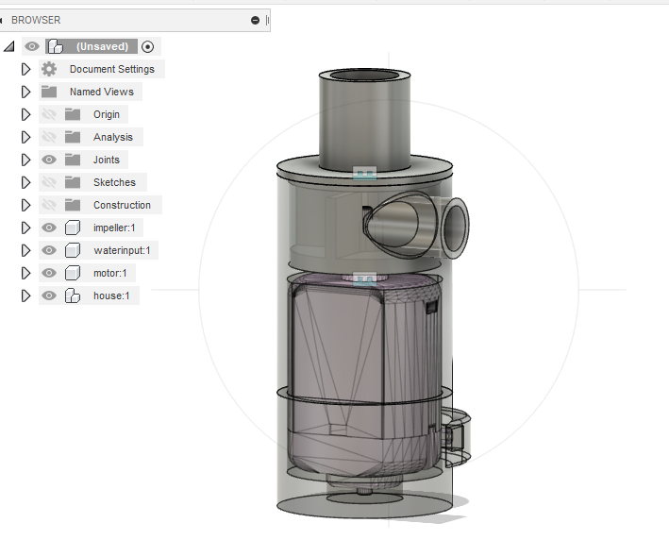
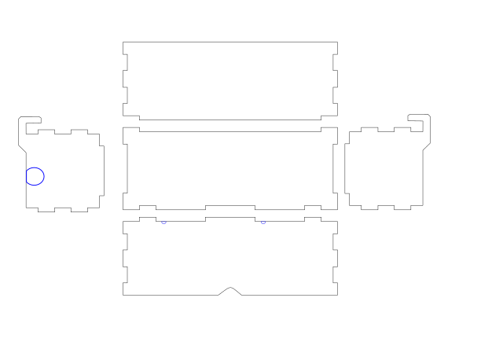
Sketching
- maintank
- pump
- minitank

Slide 3
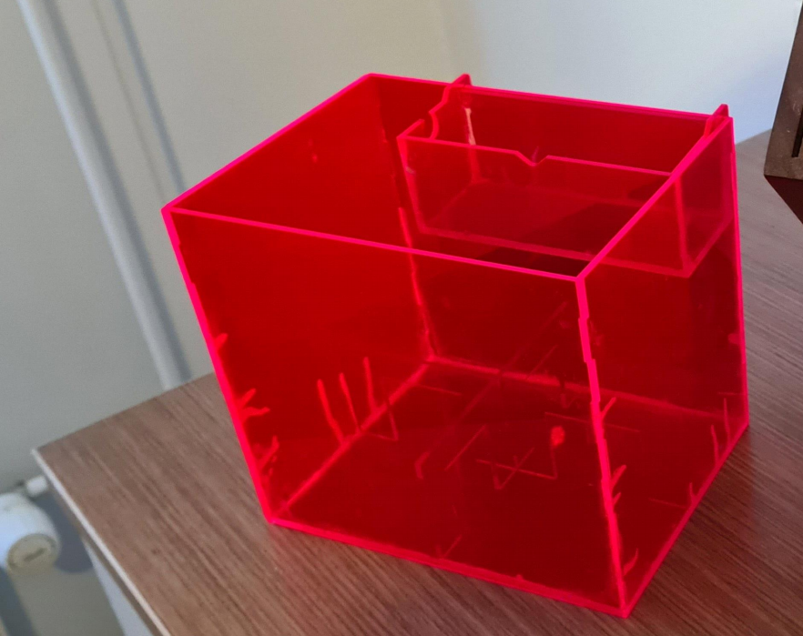
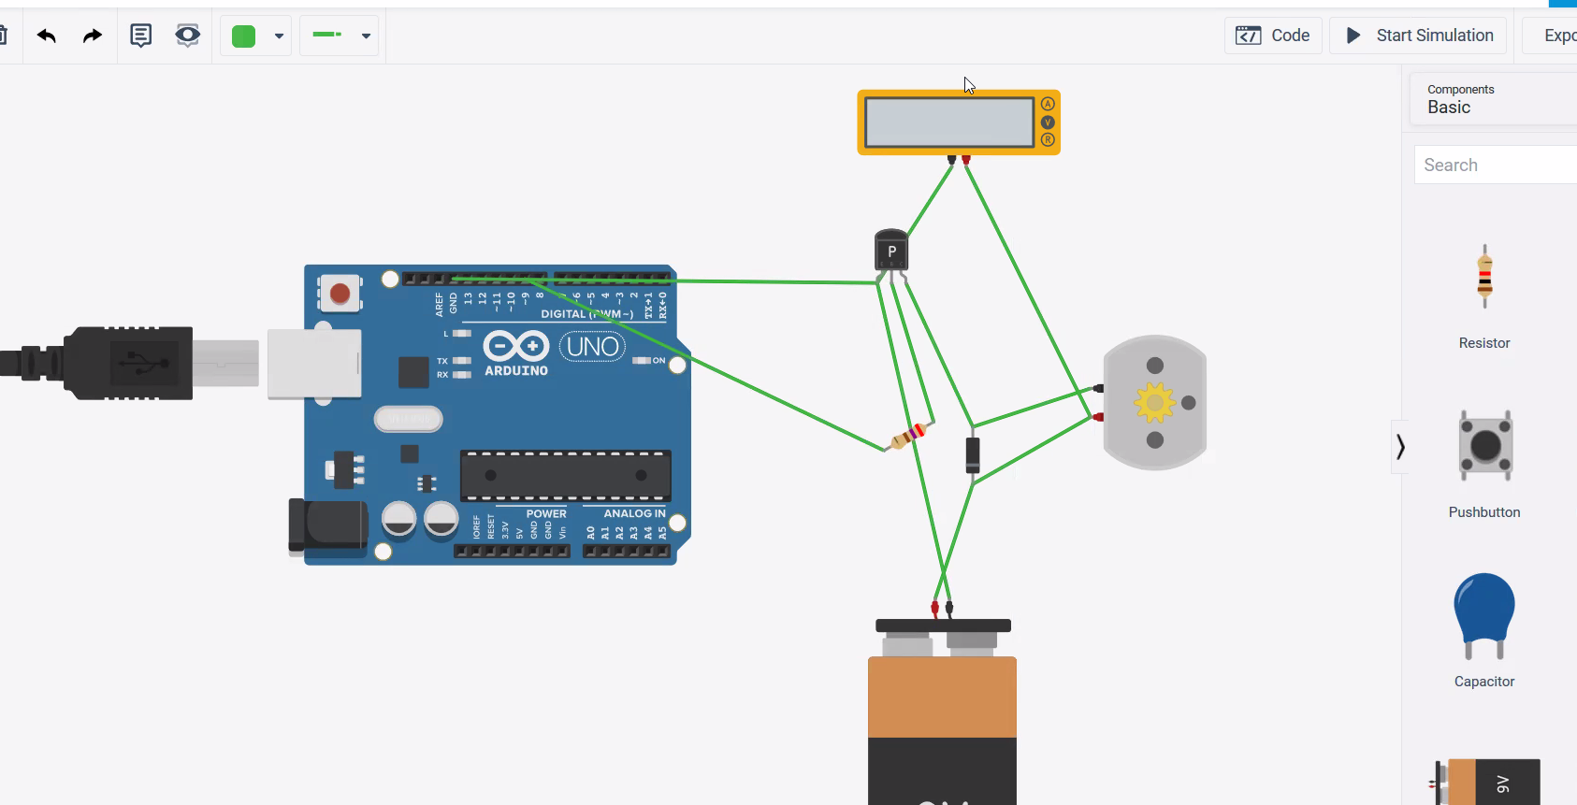
Assembled main and minitank
Holds water!
We had minor cracks while gluing it together. (Kerf 0,18 and joint clearance 0,001). We will be using greater clearance for rest of the parts
Current plan for the electronics

